Slide 1
RESPONSIVE WEB DEVELOPMENT
RWD Basics and Essentials
LEVEL – BEGINNER

Slide 2
Harikrishnan K K ( 327721)
Associate-Projects EBA –Cognizant Interactive
V1.0 - 21/04/2014
2014

Slide 3

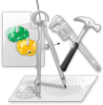







Icons Used
Hands on Exercise
Questions
Tools
Coding Standards
Test Your Understanding
Reference
A Welcome Break
Demonstration
Contacts

Slide 4
OVERVIEW
WHAT?
RWD is a concept, a discipline or a set of design principles which allows a website to respond or adapt to a different viewport size, irrespective of its size (desktop/tablet/mobile) or a domain/sub domain (site.com & m.site.com) for people with mobile devices.
WHY?
The browser landscape is no longer restricted to desktop, with devices becoming smaller & larger simultaneously.The web has moved beyond the horizons of desktop. So creating custom experiences for every new browser, & device resolutions will be almost impossible to do, and a nightmare when it comes to maintainability even if we do so.
HOW?
The aim is to adapt to the constraints of the browser window or the device in which the same is being rendered, thereby creating a design that respond to the user needs.

Slide 5
Objectives
After this chapter you will be able to:
Understand the three basic pillars on which the concept of RWD is built upon ( pure front end layout specific )
Fluid Grids & typography
- Em compounding issue
- The concept of Context.
Fluid Images
-Browser specific issues.
Media Queries
- Cascading Inheritance
- Progressive enhancement Vs Graceful degradation
- Mobile First Vs desktop First approaches.

Slide 6
Some of the frequent requirements that we encounters
I already have a website built with fixed dimensions ( in pixels ), but now I would like to have support for tablets /mobiles / both with the help of Responsive Web Design.
I am planning to build a website / web application from scratch and I would like support for desktops, tablets and mobiles.
I would like to start with a mobile version of my website, but later I may or may not develop a tablet version or a desktop version in future.
HOW CAN RWD BE USED TO FULLFILL THE ABOVE REQUIREMENTS ?

Slide 7
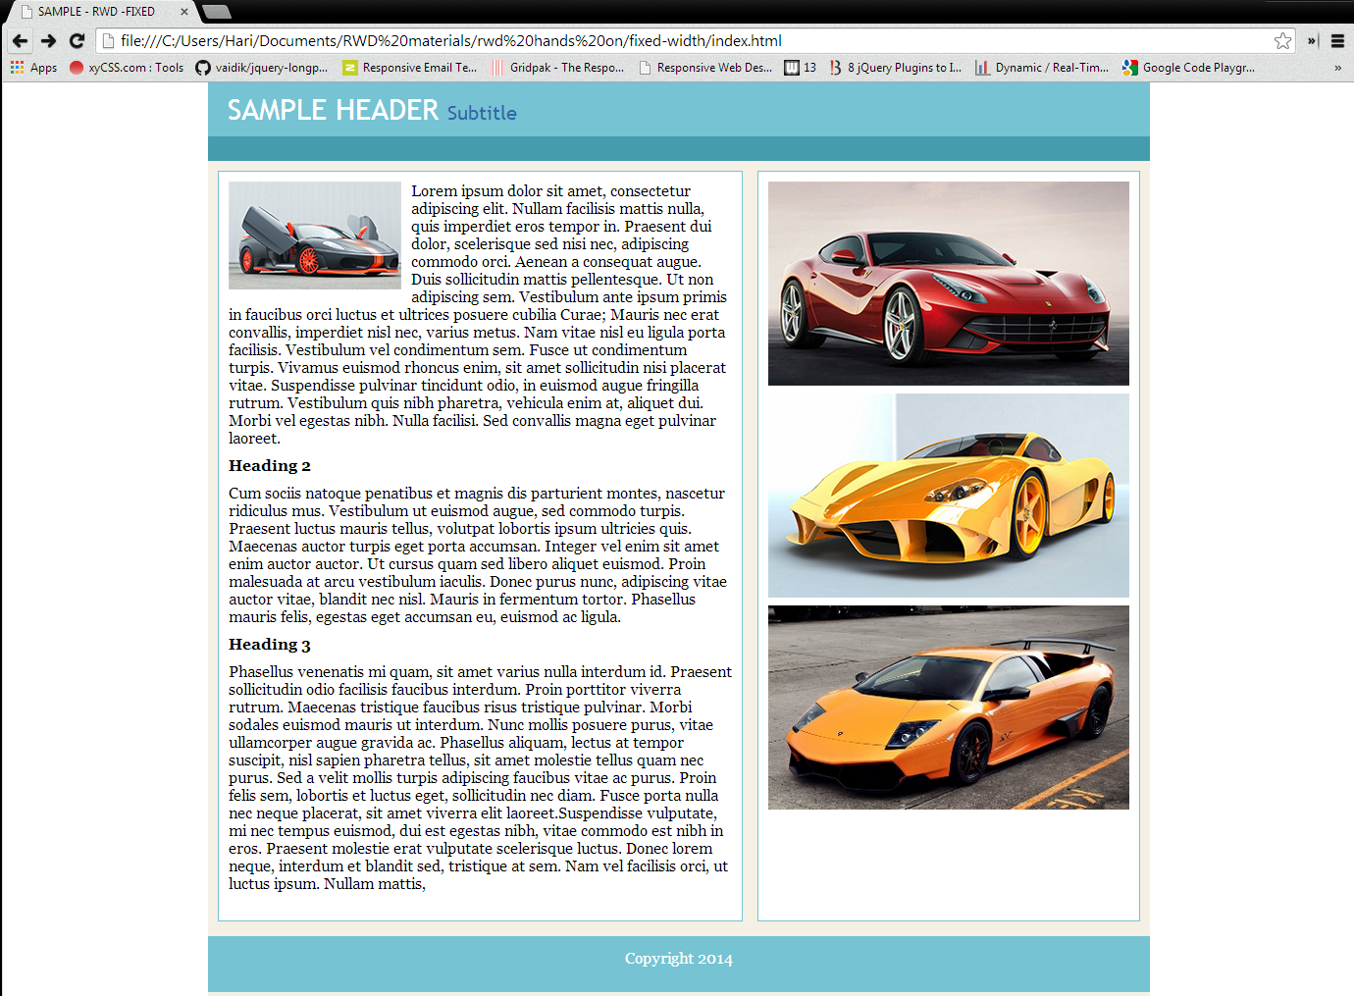
A sample fixed width blog
Browser viewport
960px container with margin:auto on either side

Slide 8
Make the fixed width blog responsive by applying the three concepts
Step 1:
we need to make the layout fluid and along with it, make the typesetting relative.
For the purpose of relative typesetting, think in terms of proportions so that we can express the pixel based font sizes in relative terms (“ems” instead of “px”)
Step 2:
make the images fluid so that it can respond to the various screen sizes and resolutions
Step 3:
explore how Media Queries can help us change the layouts and design and adapt the design for various resolutions and devices.

Slide 9

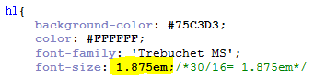
RELATIVE TYPE SETTING & FLUID GRIDS
Browser’s default base size, in almost all browsers is 16px
Setting a font-size to 100% is same as setting it to the default browser font size.
The golden formula for RWD is:
For having a flexible typesetting (making font pixel independant ):
Target → font size of the element under contention
Context → Font size of its containing element.
30px ( font size of <h1> ) → Target
Context: 16px, assuming , base font size set to 100% for the body

Slide 10
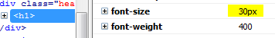
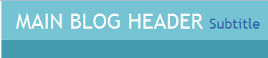
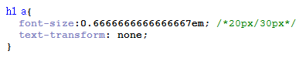
AWARE OF THE CONTEXT
Therefore, 30px/16px → 1.875em. We can confirm whether the computed value is right or not in firefox/chrome debugger:
THE CONCEPT OF “CONTEXT”
The anchor tag inside the <h1> has a font-size of 20px. But the point to remember is its context. For the anchor tag, the context is <h1> and not <body> tag, whereas, for the <h1> the context we have taken was the <body> tag.
Applying the target/context = result formula, Target: <a> : 20px, Context: <h1> : 30px;
Result = 20/30 → 0.6666666666666667em.
Verify the same in the firefox/chrome debugger as well.

Slide 11
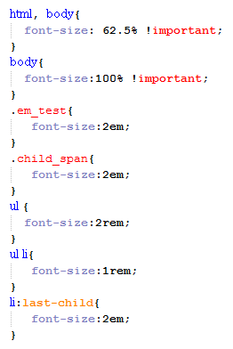
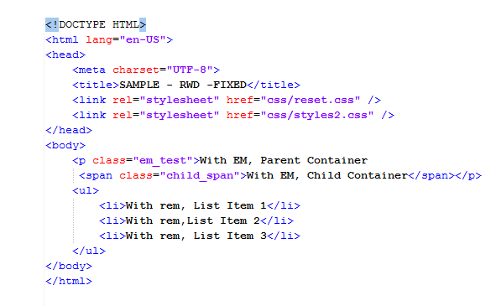
The problem of “em” compounding When to use em and rem?
When we convert a px to em, we have to deal with the problem of em compounding.
Usually, 1em = 16px = 100%.
By setting the font-size:100% to the root, we can substitute 16px with its equivalent of 1em.
But for the ease of calculation, it would be easier if the value is a multiple of 10.
For html( which is the root )
If we set the font-size:62.5%, then 1em corresponds to 10px instead of 16px.
So that 1.5 em → 15px, 1.9 em → 19px and so on.
So if we set font-size:100% on body, it means, the 10px on the parent <html> needs to be applied to <body> as well.
10px
20px
40px
20px
10px
40px

Slide 12
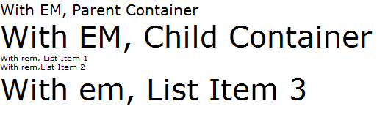
The compounding issue
The paragraph with the class “em_test” was set with a font-size of 2em.
Therefore 1em being 10px, 2em becomes 20px. But, the child of this paragraph, the <span> “child_span” is also set to 2em. We expect this to be 20px, by setting it to 2em, but, due to compounding, instead of taking the root value of 10px, it looks for its immediate parent, which is the paragraph which already has a font size of 20px. So as far as this <span> is concerned, 1 em is 20px, and for 2em, it doubles the value to 40px.
REM- or “Root EM” always refers to the root value only.
The <ul> which is set to 2 rem, gives 20px ( 2 * 10px ) and its children, the <li> list items, which is set to 1em, gives 10px itself as expected.
To distinguish, we have changed the last child of the list to em. Here, instead of taking the reference from the root ( html, with 10px), it immediately looks for its parent ( <ul> )
<ul> has 20px, therefore, 2em , from the point of view of the last list-item is 40px.
20px
40px
10px
40px

Slide 13
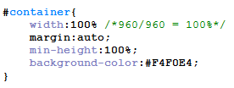

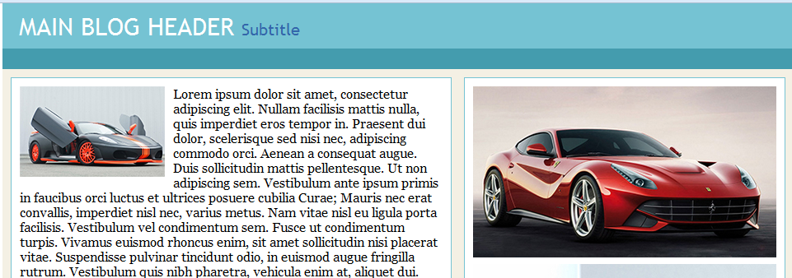
EXTENDING THE FLEXIBLE TYPESETTING TO GRIDS
Apply the same calculation formula to express the rows and columns in proportion to their containing elements.
#container is the outer most container that holds the entire blog. We assume that this should span the whole width of whichever device the same is rendered in. The header occupies the full width of the container its in, so the width of it is 100%.

Slide 14
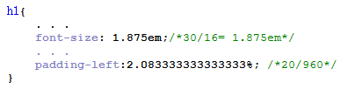
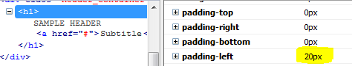
FLEXIBLE MARGINS & PADDINGS
We can also define percentage based margin and padding to preserve the integrity of the fluid flexible grid.
Two important things to remember with respect to “context”:
When setting flexible margins on an element, your context is the width of the element’s container.
When setting flexible padding on an element, your context is the width of the element itself.
The percentage value is calculated with respect to the width of the generated box's containing block. This is true for 'margin-top' and 'margin-bottom' as well.
For <h1>, the padding-left was 20px. Therefore, Target: <h1> tag, → 20px & Context: (width of h1)→ 960px
Result: 20/960 * 100 = 2.083333333333333% , if we can resize the browser to 960px , we can verify the same in debugger.

Slide 15
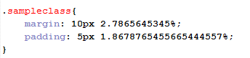
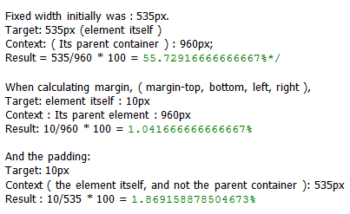
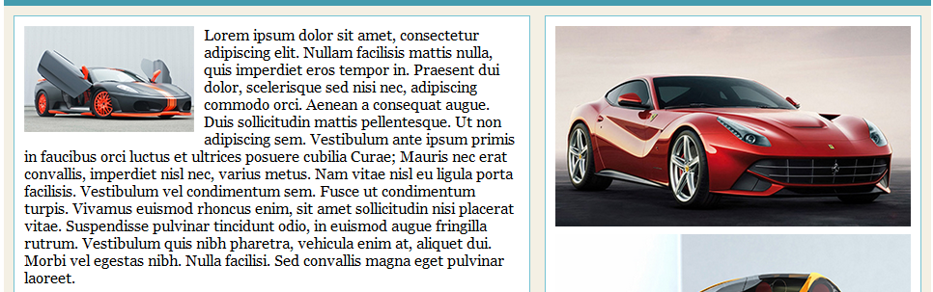
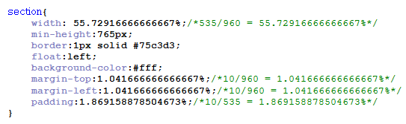
<SECTION>
The choice of pixels and percentage is purely based on what the design needs in that context.
Just because we have set the margin-left and margin-right, or padding-left and padding-right in percentage does not mean that margin-top , margin-bottom, or padding-top, padding-bottom also should be expressed in percentage. We can get the best of two, by combining the two. That decision is more of an aesthetic one rather than following them strictly. We can also use it like the example shown below.
960px
SECTION ELEMENT
ASIDE ELEMENT
535px width
390px width

Slide 16
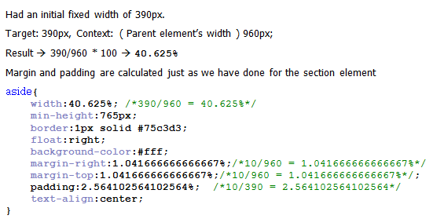
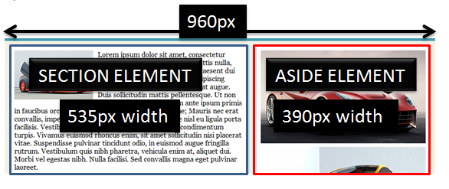
<ASIDE>
Having a dynamic padding isn’t necessary always. We should take a look at the layout on various resolutions to decide that. Though implementing a fluid design is beneficial for all, implementing a dynamic padding is more of an aesthetic decision that the designed should take with the end-user in mind. ie, user-centric focus. If the design can bare a fixed pixel value on all resolutions, there is nothing wrong in using pixels.

Slide 17
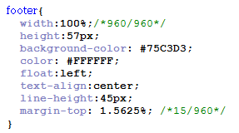
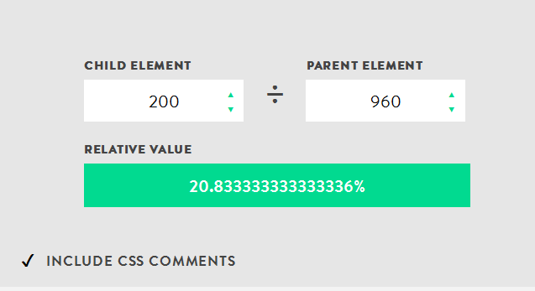
<footer>
We will apply the same formulas we used for calculations:
We have converted the fixed width websites
into a fluid one with flexible grid and flexible
typesetting. It would be ideal not to round off the
percentage values to two decimal and leave the actual percentage calculated value as itis.
ONLINE CALCULATOR:
http://hoverstud.io/calculator/#
Notes:
Few rwd tools:
http://www.hongkiat.com/blog/rwd-tools/
http://mattkersley.com/responsive/
http://www.creativebloq.com/responsive-design-tools-8134180

Slide 18
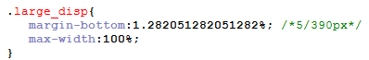
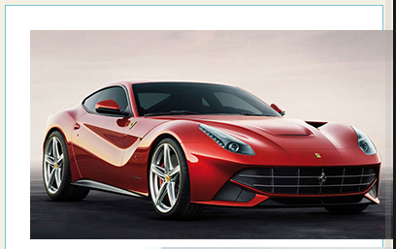
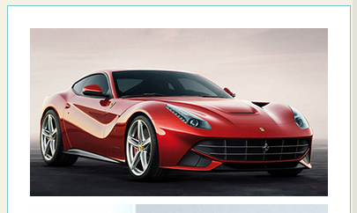
FLEXIBLE IMAGES
Moving to the next pillar in RWD – Flexible images.
When we introduce fixed width images into flexible grid layout design, the design breaks at some point.
The image goes out of the layout. Setting max-width:100% to the image will make it fit inside the container it is residing in.
Now, our img element will render at whatever size it wants, as long as it’s narrower than its containing element. But if it happens to be wider than its container, then the max-width: 100% directive forces the image’s width to match the width of its container. As our flexible container resizes itself, shrinking or enlarging our image, the image’s aspect ratio remains intact.

Slide 19
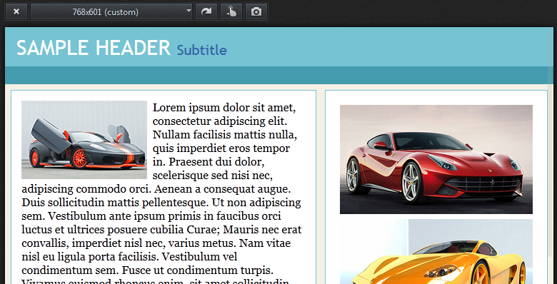
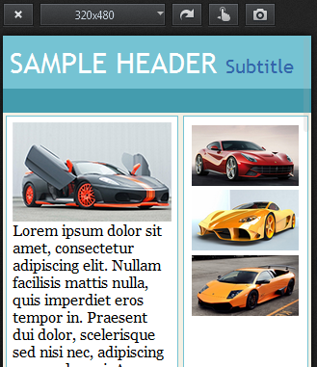
ON LOWER RESOLUTIONS
Upon resizing to the width range of a tablet (768px width, taken on firefox responsive inbuilt addon – Ctrl + Shift + M) and then on a mobile (320px )
The images resize accordingly
based on its container’s width

Slide 20
Browser specific issues on flexible images
IE6 and below doesn’t support max-width property. But IE7 and above has support, and buggy till IE8 because, max-width combined with overflow-auto/scroll has some bugs.
To cater to IE6, We can have an IE specific stylesheet within which, we can write,
img, embed,object,video {
width: 100%;
}
max-width: 100% instructs our images to never exceed the width of their containers,
width: 100% forces our images to always match the width of their containing elements.
And to make our images flexible for IE, the workaround is to include the filter:
Simply download the script and include it on any page with flexible images; it will go through your document to create a series of flexible, high-quality AlphaImageLoader objects.
Notes:
Script for filter available at:
http://unstoppablerobotninja.com/entry/fluid-images

Slide 21
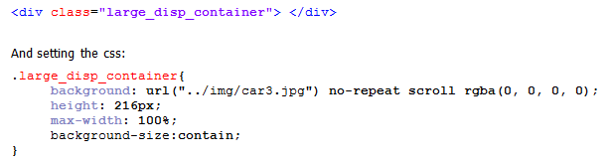
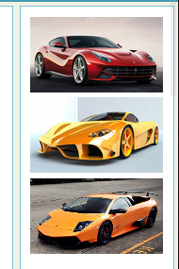
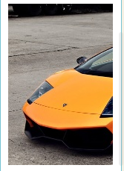
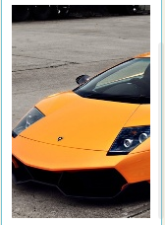
BACKGROUND IMAGES
What about images which are not in the markup?
CSS3 property called background-size allow us to create truly flexible background images, but use it carefully, as cross brwoser support, espicially on IE8 and below is a problem. By setting the background-size: contain, we make the image grow and shrink keeping the aspect ratio.
background-size:contain
background-size:cover
background-size:cover + background-position

Slide 22
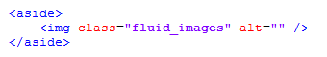
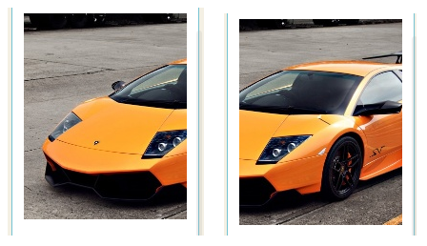
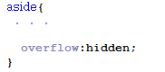
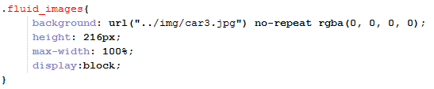
background-size options
By setting the background-size to cover, we make sure that the image is always contained inside the container it resides in, but it crops off the image outside the width it can show.
By setting the background-position along with the background-size,
We are able to display only relevant portions of the image and crop off the rest.
Applying the values “center center” to background-position will always keep the image in center and crop of from either sides as the layout shrinks.
OVERFLOW PROPERTY & FLEXIBLE LAYOUTS

Slide 23
SERVER SIDE SOLUTIONS?
Both the overflow and max-width: 100% approaches to flexible images are actually pretty robust, and work remarkably well for most kinds of media. But both approaches are ultimately “content-blind.” That is, due to various restrictions and limitations, the actual content is getting blinded. (shrinked/cropped etc )
max-width: 100% scales oversized images down to match the width of their containers, while controlling overflow allows the designer to conceal any image data that might bleed out of its containing element.
In case of cropping or content-blinding produces undesirable results:
We can deliver different versions of the same image to different resolution ranges ( One for desktop, another for smaller mobile devices etc ) along with a server side solution that could serve the appropriate image for that resolution range.
It is also possible to serve images to a limited number of resolutions and then using the techniques we have mentioned before, eg: using max-width:100%, to smoothy transition to other devices , browsers and resolution ranges on a needy basis.
Read more:
http://css-tricks.com/which-responsive-images-solution-should-you-use/
http://www.smashingmagazine.com/2014/02/03/one-solution-to-responsive-images/
http://www.hongkiat.com/blog/serving-responsive-images/
http://responsiveimages.org/

Slide 24
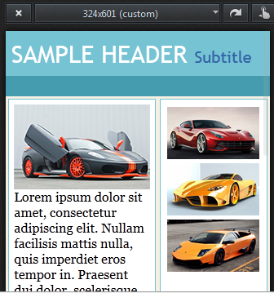
MEDIA QUERIES
Media Queries form the 3rd pillar of RWD.
Although the design here, is fluid, and it reduces the whole content based on
percentage, beyond a point, merely shrinking the content is not what we want.
The images of the cars on the right, will not be of much use if we shrink them
beyond a certain size.
What we actually want is the layout to reshape so as to provide the existing
design in a more efficient way to create a much better User Experience. We
Just don’t need a reduced , shrinked version of what we had in desktop, stripped
of pixels and re-designed using percent.
May it be a fixed design, or a fluid design, none of these will scale well beyond the
Context for which it was originally designed. We need our design to adapt to the changes in screen resolution
And viewport dimensions. The page should optimize itself for various browsers and devices which accesses them.
That is, “the page should respond”

Slide 25
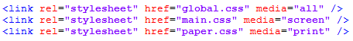
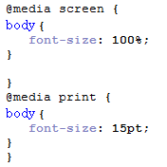
CSS2 Media Queries
Media queries were part of CSS2 itself, but the recognized medias were limited.
The recognized media types are: all, braille, embossed, handheld, print, projection, screen, speech, tty, and tv.
The aim was that, these media types will help us design for each type of browser or device by conditional loading of CSS . “all” is the superset of everything. A screen based device ignores print media type, and vice-versa.
Or using them inside stylesheets:
Upon loading the page, the browser would then render only the CSS pertaining to
its particular media type.
As per the specification, we could target the small screen browsers using the “handheld”
media type.
By the time, small screen browsers finally came to the market, there was not a lot of “handheld” CSS files available as
The browser makers decided to read “screen” based stylesheets.

Slide 26
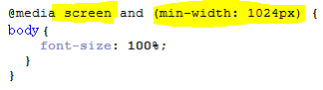
MEDIA TYPES WERE NOT ENOUGH TO UNIQUELY DISTINGUISH DEVICES OR ITS RESOLUTIONS
CSS3 media queries:
With CSS3 media queries , it could identify not only the media type, but also the physical characteristics of the device/ browsers that renders the content.
Every query had two components , A media type and a query (name of the feature : value )
If the browser meets both of those criteria, then the styles enclosed within the query are rendered. If not, the browser disregards the styles and continues. We can put queries directly inside the stylesheets as shown above.
We can also place queries on link elements by inserting them into media attributes:
Or we can attach them to @import statements

Slide 27
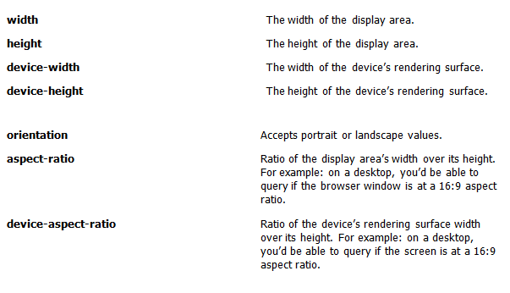
the @media approach is preferrable since it keeps your code consolidated in a single file, while reducing the number of extraneous requests the browser has to make to your server.
Every device has a display area and a rendering surface.
On a laptop, the display area will be our browser and the rendering surface can be our screen.
MEDIA QUERY PROPERTIES:

Slide 28
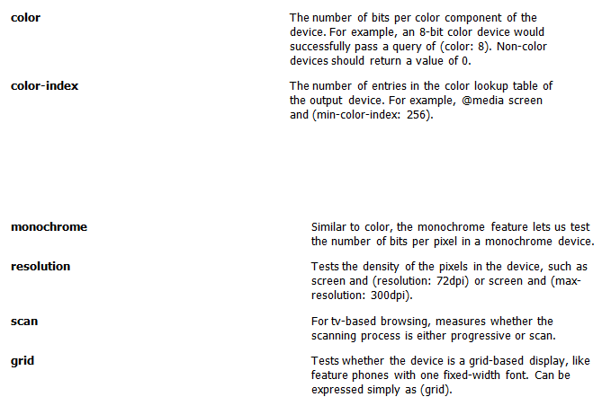
Except orientation, scan and grid, rest can have max-min prefix as needed.
We can also chain media queries to make more complex queries , or to make more specific conditions.

Slide 29
IMPORTANCE OF VIEWPORT META TAG
If we are trying to test our media query on a mobile device, it might produce unexpected results as we wont see the expected media queries applied initially. It is just that the mobile browser thinks it is a desktop browser .
By default, mobile devices like iPhone or Android zoom out on webpages automatically to give the user a more expanded view of the page.
Everything appears smaller, and more pixels are squeesed on to the screen.
On iPhone device, upto 980px of a webpage are shown, and on android devices, 800px.
The benefit of this was that, the non-mobile optimised webpages appear manageable to smaller screen, and the user need not have to swipe a lot to access various sections of the page.
If the page is optimised for mobile device via CSS media queries and changing the layout of the webpages accordingly, then the “zoomed out “ pages will cause problems on our efforts.
Our CSS media queries will match the dimensions of the zoomed out devices and not its actual dimensions.
(ie, 980px for device-width on iPhone instead of 320px )
So when we optimize the page for mobile devices, the very first step is to define a “meta” tag on the page to alter or disable the “zoom” behavior of the mobile browsers.
The viewport meta tag lets us modify the “virtual viewport” of the mobile device to something different than the default , which is to zoom out on a webpage , so its entire contents are visible on the screen. Here, we are telling the mobile device to display the page without any zoom.

Slide 30
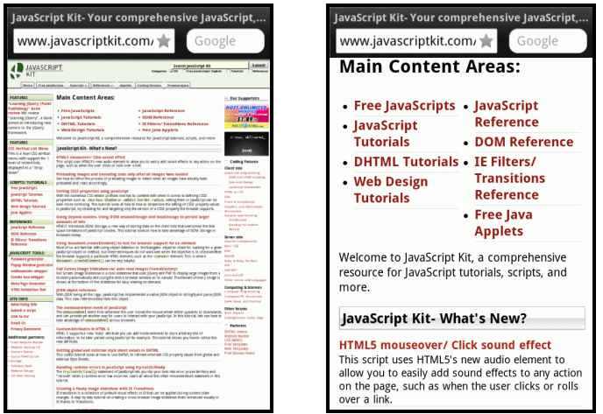
WHY VIEWPORT META TAG?
Using meta tag is important because we use CSS media queries to alter our webpage to the available real estate on different devices.
When we write a media query for a mobile device , say for 320px,
Without viewport meta tag, mobile
browser zooms out on the page thinking
that it is a desktop browser
With viewport meta tag, the width set
to device-width , and so not automatic
zooming
Notes:
References:
https://developer.apple.com/library/ios/documentation/AppleApplications/Reference/SafariWebContent/UsingtheViewport/UsingtheViewport.html#//apple_ref/doc/uid/TP40006509-SW25

Slide 31
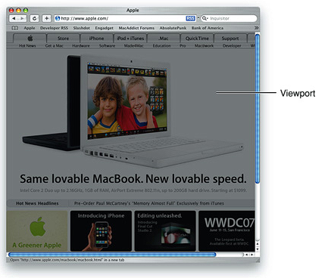
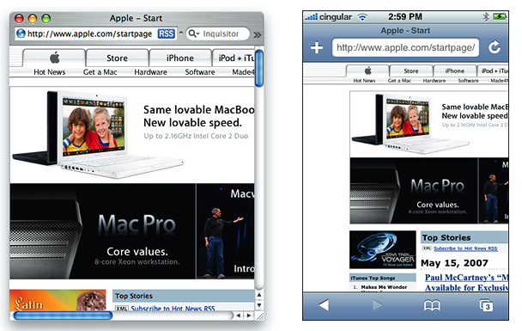
What is Viewport?
Viewport on a desktop and viewport on iOS are different
Safari on Desktop and iPhone:
Viewport on desktop is the visible area of the webpage.
DESKTOP

Slide 32
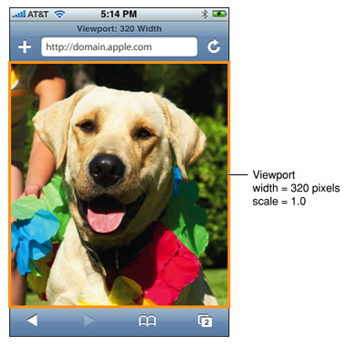
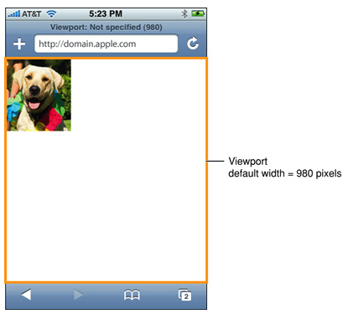
Viewport on iOS
iPhone containing a 320 X 356 px image ,
that is rendered for the first time using
the default viewport settings
Viewport width set to 320px
IMPORTANT :
The viewport can be larger or smaller than the visible area

Slide 33
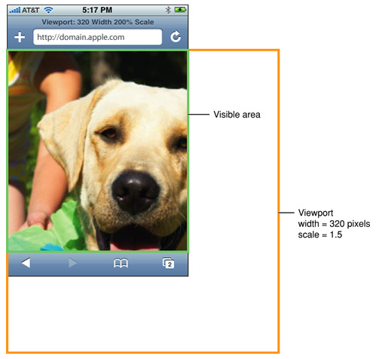
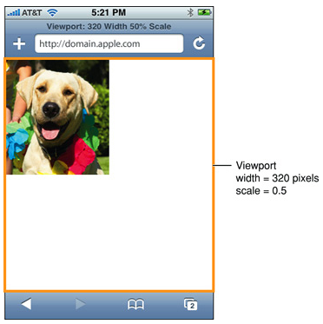
Viewport larger than the visible area:
Webpage smaller than the viewport
Because iOS runs on devices with different screen resolutions, we should use the constants instead of numeric values
So use “device-width” for the width of the device and “device-height” for height in portrait orientation.
Notes:
References:
https://developer.apple.com/library/ios/documentation/AppleApplications/Reference/SafariWebContent/UsingtheViewport/UsingtheViewport.html#//apple_ref/doc/uid/TP40006509-SW25

Slide 34
To set the initial scale and to turn of user scaling:
IMPORTANT:
For web applications specifically for iOS, the recommended size for the web page is the size of the visible area on iOS. Apple recommends that, we set the width to “device-width” so that the scale is 1.0 in portrait orientation and the viewport is not resized when the user changes to landscape orientation.
More read:
https://developer.apple.com/library/ios/documentation/AppleApplications/Reference/SafariWebContent/UsingtheViewport/UsingtheViewport.html#//apple_ref/doc/uid/TP40006509-SW25

Slide 35
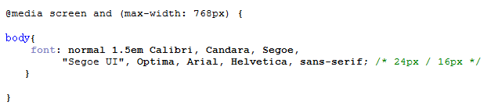
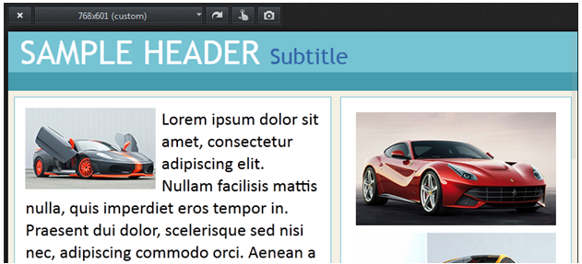
PUTTING IT INTO ACTION ON THE BLOG
For better readability, the font size is increased on resolutions below 768 ( tablets / mobile range )
The good thing about writing in this fashion is that, the query only overwrites those properties that we need to change. Here, the font size increases once the viewport snaps below 768px.
1.5 ems

Slide 36
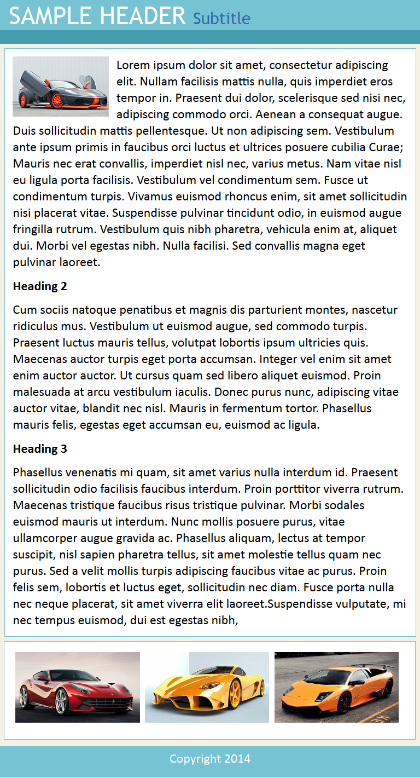

OPTIMIZING FOR TABLET VIEW
Tablet specific styles:
NOW ASIDE COMES
BELOW SECTION
Images are given a width of 32%
And are floated left so as to come on a single line

Slide 37


FOR THE MOBILE EXPERIENCE
For the mobile version of the blog:
Brings the thumbnail
to center
Images now occupy
Full device width

Slide 38

IMPORTANCE OF CASCADING MEDIA QUERIES
When writing media queries, the cascading order is something that needs to be kept in mind.
Example for an inefficient way of writing media queries: ( or bracketing them in between an upper and a lower limit )
THE PROBLEM
We are defining an upper and lower limit.
The rules are defined between two ranges, instead of inheriting from the highest resolution ( for a desktop centric approach)
Mobiles and tablets can have a lot of styles in common, and all the code will have to be duplicated between two set of media queries if we bracket them.
SOLUTION:
The better way would be “Cascading Inheritance” from the highest resolution to the lowest or vice versa.

Slide 39

Cascading from largest to smallest ? Or vice-versa? Depends on whether we adopt Mobile first approach or Desktop first approach.
Graceful Degradation Vs Progressive enhancement.
Graceful degradation arise out of a need that, our design should function in as many browsers, devices and platforms as possible.We wanted to take advantage of the new technology without excluding the users with setups that did not have the support. The approach was to serve the best possible experience for those device and browsers which can accommodate it, and then account for each possible degradation and ensure that the site is still functional.A standard website will scale back and gradually remove contents and features as the viewport becomes smaller.
On Progressive enhancement, we focus more on the mobile platform, providing the users with minimal screen real estate, processing power, and third party plugins an amazing experience. As the need arises, site can gradually be enhanced for the higher resolution based ones.
MOBILE FIRST
DESKTOP FIRST

Slide 40

Advantages Vs Disadvantages of Graceful Degradation and Progressive Enhancement
For a mobile first approach:
Bare minimum CSS styles can be used to target mobile devices first.
For desktop and tablet, using media queries, more complex and advanced CSS can be applied.
Improved speed and rendering time for mobile devices since media queries are not computed.
Difficult for complex designs.
For a desktop first approach:
Desktop, tablet & mobile designs are based off the same design with smaller resolutions simply removing elements or altering styles.
For a complex design, much easier to use.
Easier to scale fluid websites from a larger size to a smaller one.
Where & how do cascading inheritance of Media Query fits in all of these?

Slide 41
Cascading Inheritance
Using an upper and a lower limit using max- and min- does not allow for inheritance between resolutions.
So for a desktop first approach, only use max-width and for a mobile first approach, only use min-width.
So, tablet will inherit desktop rules (since they are defined by default ), and mobile will inherit tablet and desktop rules. ( both are defined previously )
The same concept used in reverse for mobile first using min-width. These approaches are superior as it reduces code complexity and repetition.

Slide 42


DESKTOP FIRST APPROACH cascading..
STYLES
Common General styles
For 1024px
Tablet specific
Styles (768px)
Wide mobile
Styles (480px)
Small mobile
Styles (320px

Slide 43


Mobile First Approach Cascading…
STYLES
.
Minimum styles
for mobile
Add more for
tablet
Add more for
desktop

Slide 44
PROS & CONS
The problem with desktop first approach is:
Even if we have a default style and a resolution specific media query overriding the default stylesheet at a later point of time, the assets ( images ) have to be downloaded twice even if only one asset is applied in the end.
The users on smaller screens are forced to download high resolution image as well though they see only a smaller version of it.
When we start with a desktop first approach, we tend to take advantage of everything the desktop platform can offer, and later find out that the same doesn’t work as expected on a mobile platform.
All of the content ( text, image, video, audio ) is served up at the same time to the largest platform and from that point, we think about the mobile versions by either ignoring or removing certain parts from the page.
The problem is, we have already loaded everything whether the given platform needed it or not.
We served more content than is necessary on a platform that is associated with the slower download speeds.
An example scenario:
We will first do the desktop version, wire up all the click events with jquery or javascript and later when it is time to switch on to mobile device, we need to think more on handling the gestures and tap events along with various problems that the mobile platform offers. ( 300 milli second time delay for tap events being one of them )

Slide 45
How mobile first edges over desktop first approach?
Mobile first concept + media queries offer a better approach.
Default stylesheet is a mobile oriented one instead of a desktop oriented one.
Layout fot the smallest screen is done first, and then usign media query to progressively enhance the design as resolution increases.
Benefit: A browser without a media query support will still get a single column layout in case the Javascript is turned off.
This gives greater accessibility to the content, and does not make any assumptions about the capabilities of the device or the browser that is rendering our design. It’s a more bullet proof way of implementing RWD.
By embracing progressive enhancement ( mobile first ), we ensure quality access for all with an enhanced experience for those devices that are capable of it.
We deal with the constraints head on at first itself.
We have already trimmed down the content to its most vital elements.
So while progressively enhancing to tablet and desktop, instead of decidign what needs to be removed from it, we can decide on what needs to be added to provide an even better user experience.
Extra resources are loaded on a need basis to platforms and devices that can handle them.
Mobile first is not easy.
The constraints to handle at first is more – Smaller screens & fewer resources.

Slide 46
BREAKPOINTS
Breakpoints are the point at which your sites content will respond to provide the user with the best possible layout to consume the information. We use these along with the CSS3 media query to alter the design and layout so that the site responds to the devices and resolutions they are rendered in.
Usually we define our breakpoints at the exact device width that we are looking to target. The most common breakpoints are:
iPhone: (320px and 480px), Tablet ( usually iPad at 768px and 1024px ) and anything above 1024
BEST PRACTICE:
Instead of being concerned with device breakpoints, the best practice is to design for the smallest viewport first. As we expand the view, there comes a point where the design demands a new layout. This is where we add the next breakpoint.
The important point is: Do not go for the standard 480px, then 768px breakpoints just because that is the standard, but choose breakpoint at the point where your design demands it so that it could give the user a better user experience.
As more devices with extreme wide resolution comes in the market, the best practice is to set a max-width for the container.
Have a list of devices that we needs to support, group them to get a fair idea about the screen size and resolution.
Include the design and development team in all phases to check for feasibility and suggestions. The goal is to bridge the gap between design and development cycles to produce a finished responsive design.
Why mobile first ?
This is the best approach when it comes to responsive design. This allows us to layout the content that is most important for the website/client in a clear and logical way on the smallest screen space.
This approach will force us to focus on the most important information on the website/ application.
Notes:
References:
http://responsivedesign.is/strategy/page-layout/defining-breakpoints
http://responsivedesign.is/develop/browser-feature-support/media-queries-for-common-device-breakpoints

Slide 47
The importance of “Context”
At its most basic level, responsive design is about serving one HTML Document to countless browsers and devices, using flexible layouts & media queries to ensure that design is as portable and accessible as possible.
RWD is not intended to serve as a replacement for mobile websites. It’s a mix of design philosophy and front end development strategies.
How do we know whether RWD is right for our project or not? – Know what user’s goals!
Asking the mobile user to download unwanted and not so mobile useful data is a waste of bandwidth and inclusion of extra markups & css.
Using a combination of “display:none” & media queries for those sections which we don’t need in a mobile is not the perfect approach either.
That is where mobile first approach edges the desktop centric approach.
Content is of the highest priority in a mobile first approach.

Slide 48
How do we achieve a true device agnostic design?
Think outside the standard breakpoint mindset.
Embrace the design based breakpoints mindset. Make adjustment where the design dictates.
Resize the browser window to see where the design starts to break.
Put the breakpoint, use the media query there, and then repeat the same process.
Its always important to test the responsive design in as many devices as we can. So we should not totally ignore the standard breakpoints.
Keep our design based breakpoints with highest priority and then the popular breakpoints in mind while testing the design.
Smashing magazine, a very popular web technology related website, had their breakpoints on :
320px, 500px, 610px, 650px, 800px, 1020px, 1220px, 1450px , thereby breaking the popular breakpoint concept and framing breakpoints where the design demanded it.
Notes:
References:
http://tangledindesign.com/deciding-what-responsive-breakpoints-to-use/

Slide 49
Internet Explorer support for Media Query?
For IE8 and below, there is no native support for Media Query
Workarounds :
There are a number of Javascript based solutions to patch the browsers that doesn’t have the support.
Respond.js is a polyfill that is used to support min-width & max-width media queries for IE8 and below.
Learn more about Respond.js:
https://github.com/scottjehl/Respond
Another javascript patch is css3-mediaqueries.js:
Learn more:
http://code.google.com/p/css3-mediaqueries-js/
Which one to choose depends on the media type, and the media properties that we would like to target for our website/application.

Slide 50
Respond.js Vs Css3-mediaqueries.js
Respond JS | Css3-mediaqueries.js
More relaible ( recommended by Modrenizr, Twitter Bootstrap3, HTML5 Boilerplates ) | React in real time, and on window resize
Lighter ( 4KB ) and faster | Supports em based units
Interprets media query in any context ( In a link tag inside the head tag, as an inline CSS, using @import etc ) | Heavier ( 15KB ) and slower
Does not update on window resize. | Interprets only inline css
Supports only min-width and max-width | Lacks detailed documentation.
Does not support “em” units | Dependant on explicitly declared media type
 | - WRONG
 | - CORRECT
 | This expects a media type ( all, screen, handheld etc to be present )

Slide 51
How can I use the current web technology tools and best practices to get the most out of RWD?
When dealing with web applications, some of the clients demands multiple themes for the same design for client demos and prototyping etc.
CSS Pre-processors - LESS, SASS, RESS offers great help in making the static css concept, more a dynamic one with the inclusion of variables, functions, mixins, guard mixins, color mixins etc.
Usage of sprites.
Dealing with Retina devices – Javascript solution available in the form of Retina JS.
Usage of feature detection instead of the traditional user agent detection. Modernizr offers a lending hand in feature detection.
Using appropriate frameworks that matches the website / application reuirements
Twitter Bootstrap, Zurb Foundation, Gumby, LESS framework, Columnal, 960 gris system, Susy, Blueprint, YAML, YUI CSS Grids, Skeleton, Base, Compass, just to mention a few.
Instead of starting from scratch, make use of Boilerplate templates that gives an excellent starting point from which we can build our application/websites.
Notes:
References:
http://www.awwwards.com/what-are-frameworks-22-best-responsive-css-frameworks-for-web-design.html
http://www.noupe.com/css/5-popular-css-frameworks-tutorials-tools-for-getting-started.html
http://mashable.com/2013/04/26/css-boilerplates-frameworks/
http://speckyboy.com/2008/03/28/top-12-css-frameworks-and-how-to-understand-them/
http://designzum.com/2014/01/13/best-html-css-frameworks-2014-for-web-designers/
http://cssmenumaker.com/blog/5-css-frameworks-you-should-be-using

Slide 52


HTML5 Boilerplate
http://html5boilerplate.com/ http://www.initializr.com/
H5BP | Initializr
HTML5 ready. We can use the new HTML5 elements with confidence. | Generates templates based on HTML5 boilerplate
Cross Browser compatible (IE8+ ) | Responsive template
Designed with progressive enhancement in mind | Bootstrap 3.1.1 and Jquery 1.11.0 integrated
Uses normalize.css for css normalizations | Provides us with a clean customizable template with which we can start a new project
Latest Jquery, Modernizr incorporated & extensive documentation.

Slide 53
RWD Tools
PX to EM : http://www.pxtoem.com/
Gridpak: http://gridpak.com/
Adapt.js: http://adapt.960.gs/
Isotope: http://isotope.metafizzy.co/index.html
Tiny Navigation: http://tinynav.viljamis.com/
Responsive.is: http://responsive.is/typecast.com
Responsivepx: http://responsivepx.com/
Testing: http://mattkersley.com/responsive/
Review: http://responsiveviewport.com/
Screenqueries: http://beta.screenqueri.es/
Responsinator: http://www.responsinator.com/
Adaptive images: adaptive-images.com
Videos: http://fitvidsjs.com/
Retina JS: http://retina-images.complexcompulsions.com/
Categorizr: http://www.brettjankord.com/2012/01/16/categorizr-a-modern-device-detection-script/
Bookmark: http://seesparkbox.com/foundry/media_query_bookmarklet

Slide 54
RWD Calculator: http://rwdcalc.com/
For those who like to change media queries from javascript:
http://wicky.nillia.ms/enquire.js/
Ripple Emulator , Resolution Switcher, responsiView, - Chrome web store free tools
Fireshot - Firebug extension that helps to take quick screenshots.

Slide 55

Lend A Hand ☺
With the basic understanding of a mobile first approach, try building the same blog on a “Mobile First” approach and include a slide in navigation bar for mobile which becomes a navigation bar in Desktop version. Use the progressive enhancment techniques along with the help of media queries.
In Mobiles / Tablets
In Desktops

Slide 56


Test your understanding
Questions
Check the following HTML snippet.
HTML CSS
What is the font-size of <h1> in pixels?
10px
12px
14px
16px

Slide 57
2) Which among the following is not a basic pillar of RWD ?
Fluid Grids & Typography
Fluid Images
Media Queries
Fixed height-width Images

Slide 58
3) Which CSS3 property enables you to design flexible background-images?
background-color
background-size
color
opacity

Slide 59
4) Which among the following is used to support min-width & max-width media queries for IE8 and below?
respond.js
jquery.min.js
bootstrap.js
hammer.js

Slide 60
5) Which among the following indicates Desktop first approach?
a) b)
c)

Slide 61
Source
Attaching the hands on zip file (sample blog template demonstrated in the slides) along with this for reference
Disclaimer: Parts of the content of this course is based on the materials available from the Web sites and books listed above. The materials that can be accessed from linked sites are not maintained by Cognizant Academy and we are not responsible for the contents thereof. All trademarks, service marks, and trade names in this course are the marks of the respective owner(s).

Slide 62
RESPONSIVE WEB DESIGN BEGINNER SERIES
You have successfully completed -
RESPONSIVE WEB DESIGN BEGINNER SERIES

